Slide 1

AUTOMATED CODE REVIEW BOT
by
N.HARSHAVARDHAN REDDY
Roll No. 224G1A0526
M.NAGA SAI NAVYA
Roll No. 224G1A0555
C.CHANDRAKALA
Roll No. 234G5A0501
Under the guidance of
Mr. K. Lokeshnath, M.Tech, (Ph.D)
Assistant professor
Department of Computer Science and Engineering
Srinivasa Ramanujan Institute of Technology
Autonomous
Rotarypuram Village, B K Samudram Mandal, Ananthapuramu – 515701.
2025-2026

Slide 2
Contents
Automated code review Bot
Title Justification
Abstract
Problem statement
Objectives of Project
Literature survey for objectives
Proposed Work -(Methods to be followed for proposed system)
References
GitHub Link
Queries
Srinivasa Ramanujan Institute of Technology

Slide 3
Title Justification
Automated code review Bot
“Automated” reflects that the system performs code analysis without manual intervention, reducing human effort and time.
“Code Review” highlights the core functionality of detecting errors, analyzing logic, and improving overall code quality.
“Using NLP and LLM” justifies the use of advanced Natural Language Processing and Large Language Models to understand code semantics and provide intelligent suggestions.
The title conveys a modern system that enhances developer productivity by offering accurate, real-time code evaluation and optimization.
Srinivasa Ramanujan Institute of Technology

Slide 4
Abstract
Automated code review Bot
The Automated Code Review Bot is a software system designed to automatically analyze source code and provide detailed feedback on errors, vulnerabilities, style violations, and performance issues. Traditional manual code reviews are time-consuming and depend heavily on the reviewer’s skill and availability. This project automates the review process using rule-based analysis and machine learning techniques, ensuring consistent, fast, and objective code quality checks. The bot provides instant recommendations, allowing developers to improve code quality early in the development cycle and reduce overall development cost and time.
Srinivasa Ramanujan Institute of Technology

Slide 5
Problem Statement
Automated code review Bot
Modern software development involves frequent code changes, making manual reviews slow and prone to human error. Developers often miss hidden bugs, security vulnerabilities, and performance bottlenecks due to time constraints. Inconsistent coding styles across team members further increase maintenance challenges. There is a growing need for an automated system that can continuously analyze code, detect issues, and enforce coding standards with minimal human intervention.
Srinivasa Ramanujan Institute of Technology

Slide 6
Objectives of Project
Automated code review Bot
To develop an Automated system that can automatically detect syntax errors, logical issues and missing components in multi-language code.
To provide intelligent optimization suggestions that improve code readability, performance and maintainability.
Develop an intelligent recommendation mechanism focused on code optimization to support developers in writing cleaner, efficient code.
Srinivasa Ramanujan Institute of Technology

Slide 7
Automated code review Bot
Literature survey
Early generation: rule-based linters and static analyzers (lint, PMD, CodeQL, eslint, pylint) were the first “bots” that could comment or fail CI checks on PRs. These are precise but limited to encoded rules.
ML era: over the 2010s and early 2020s, researchers applied ML to source-code tasks (bug detection, code clone detection, reviewer recommendation), expanding automation beyond fixed rules. Surveys summarize those trends and the limits of classical ML approaches.
LLM era (2023– ): instruction-tuned LLMs are now used to generate natural-language review comments, explanations, and suggested edits — enabling richer, contextual reviews
Srinivasa Ramanujan Institute of Technology

Slide 8
Proposed System
Automated code review Bot
Our project is designed to automatically analyze the code and give feedback to the user.
The feedback can be error detection, suggestions or optimization of the code.
We uses a LLM Model where:
It automatically analyzes the code and give the feedback to the user.
It automatically detects how the problem can be easily solved whether using recursion, loops or any other methods.
The main goal is to make the development process faster and easier.
Srinivasa Ramanujan Institute of Technology

Slide 9
References
Automated code review Bot
Cihan, Umut, et al. "Automated code review in practice." 2025 IEEE/ACM 47th International Conference on Software Engineering: Software Engineering in Practice (ICSE-SEIP). IEEE, 2025.
Martins, Gustavo F., Emiliandro CM Firmino, and Vinicius P. De Mello. "The Use of Large Language Model in Code Review Automation: An Examination of Enforcing SOLID Principles." International Conference on Human-Computer Interaction. Cham: Springer Nature Switzerland, 2024.
Tufano, Rosalia, et al. "Code review automation: strengths and weaknesses of the state of the art." IEEE Transactions on Software Engineering 50.2 (2024): 338-353.
Srinivasa Ramanujan Institute of Technology

Slide 10
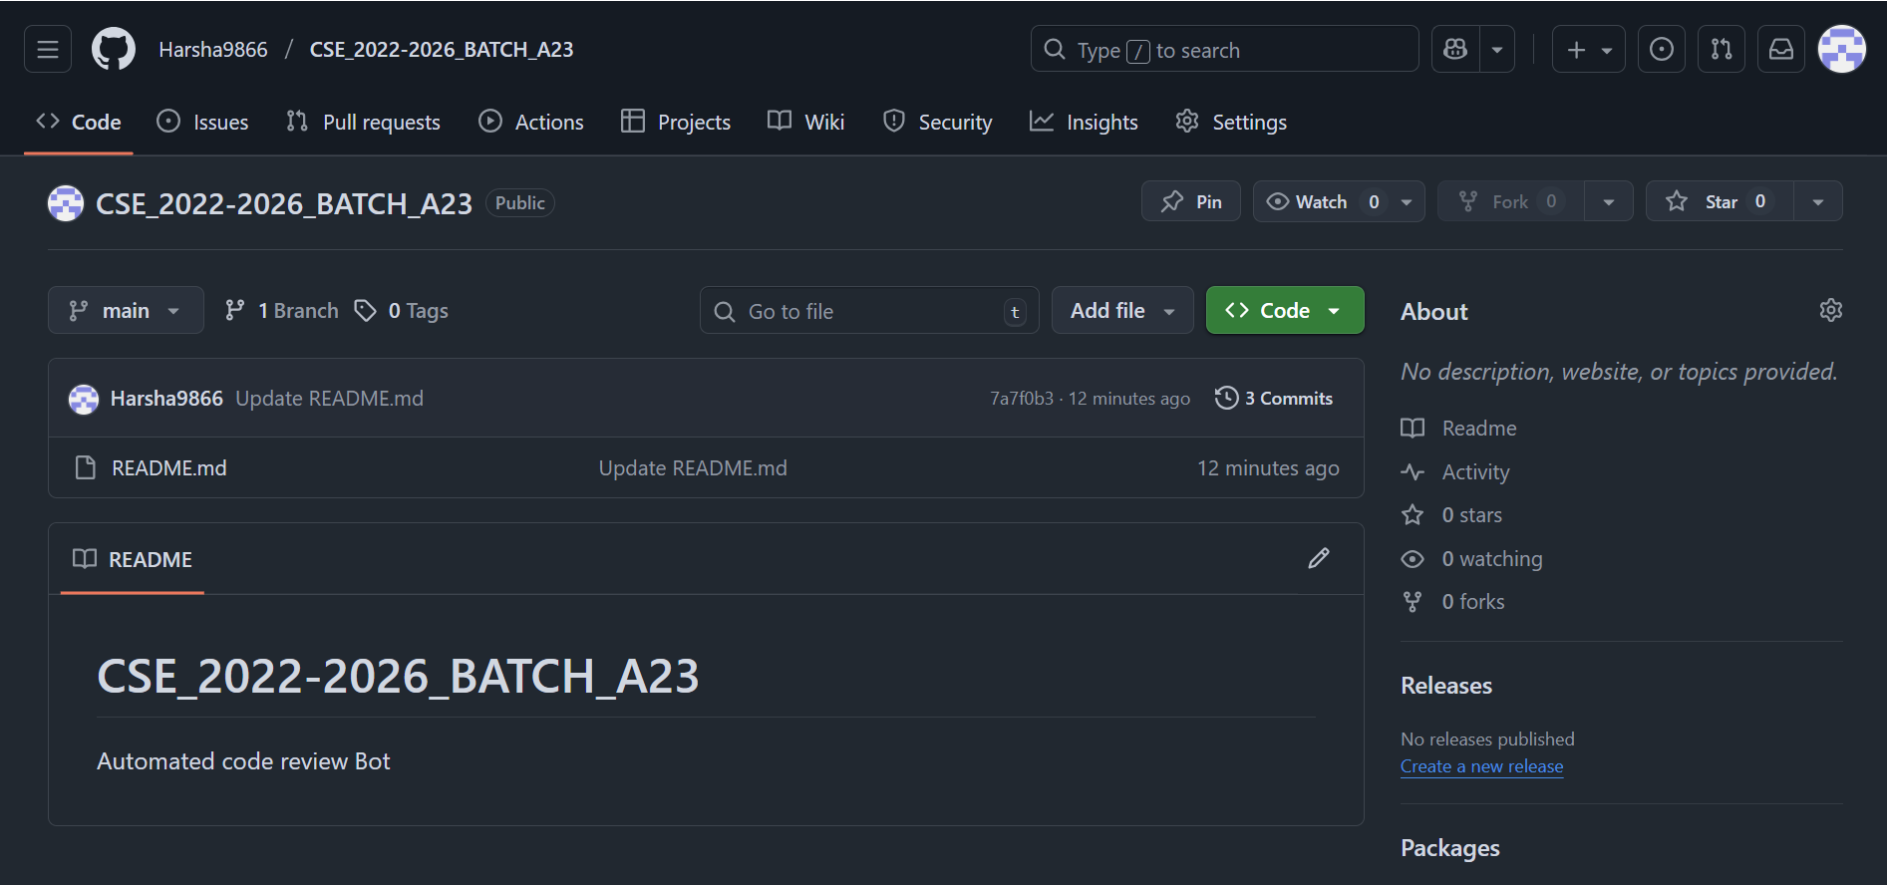
Git Hub Dashboards of each student
Automated code review Bot
link of the GitHub: https://github.com/Harsha9866/CSE_2022-2026_BATCH_A23
Srinivasa Ramanujan Institute of Technology

Slide 11
Any Queries?
Automated code review Bot
Srinivasa Ramanujan Institute of Technology

